Slide 1
SQL Injection detector
Claire Burn 40058951
Language: Python

Slide 2
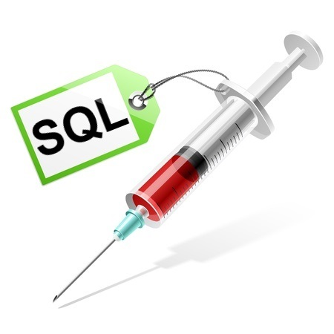
Introduction
SQL Injection is one of the top 10 web app vulnerabilities according to OWASP.
Can be used to delete company data, or steal sensitive information.
Can be avoided with the correct validation.

Slide 3

Detection
Many approaches have been tried and tested:
Black lists – Allow-by-Default
White lists – Deny-by-Default
Parameterisation of queries on the server side (prepared statements)

Slide 4
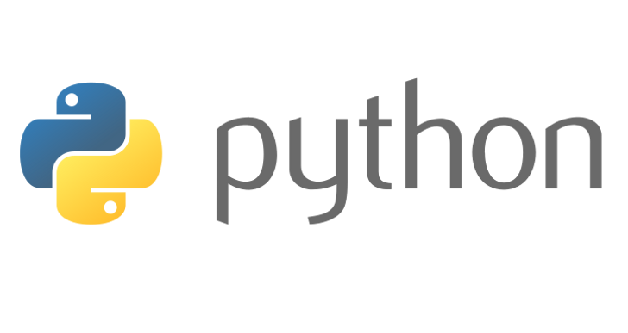
My approach
Hybrid of syntax checking, white list and black list.
Using Regular Expressions
Implemented in Python (2.7 and 3)

Slide 5
SQL Injection Attack String
Filter
Syntax Check
White List
Black List
Clean SQL
SQL Query

Slide 6
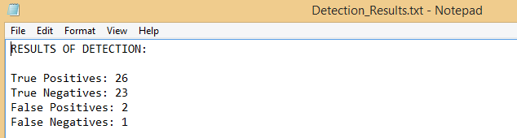
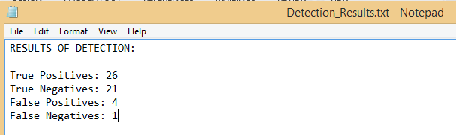
Results 90% - 95% Correct Classification
Without File Import
With File Import

Slide 7
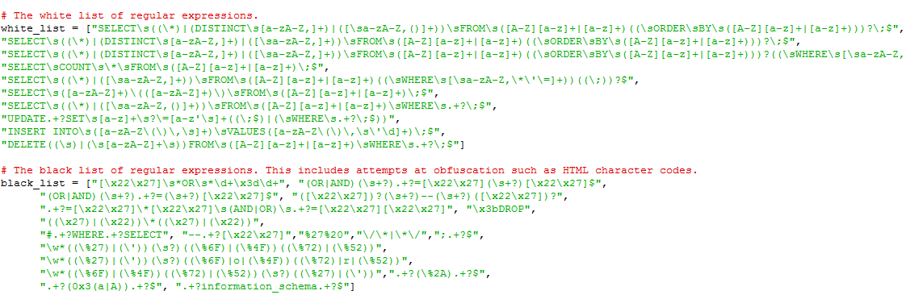
Code Walkthrough

